Slide 1
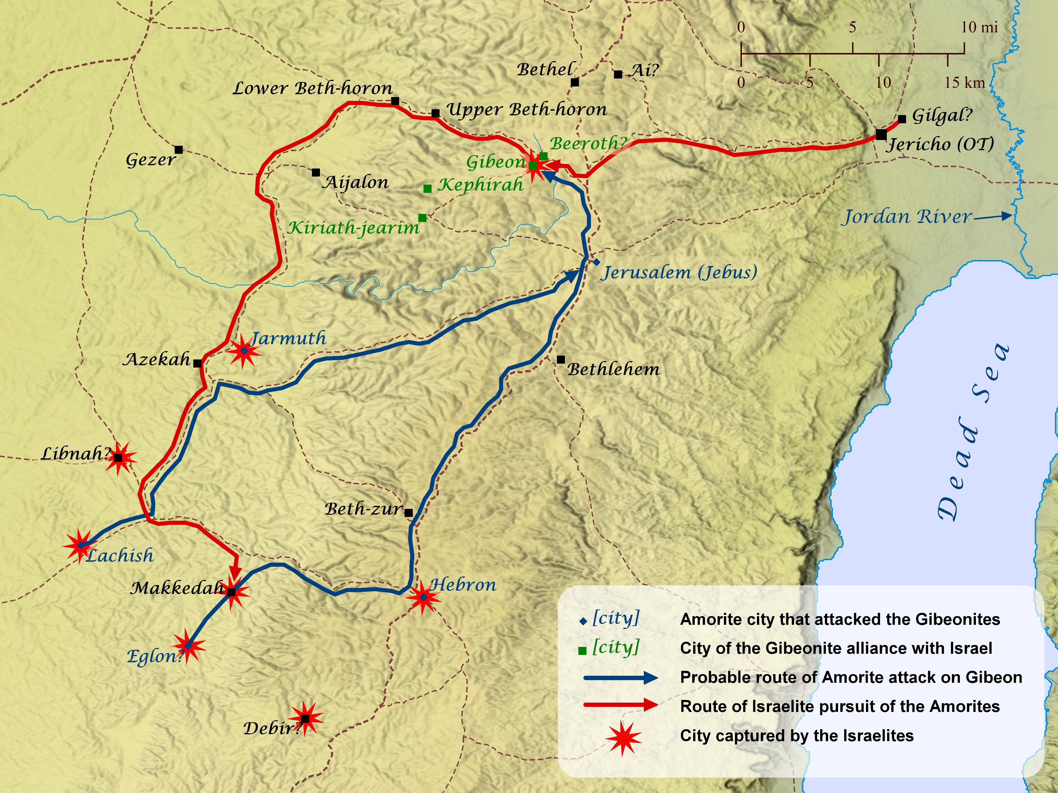
Map of Joshua 10
Notes:
Is This Genocide? Is God commanding Genocide?
Map from BibleMapper.com
“The Bible story of Joshua’s destruction of Jericho and the invasion of the Promised Land in general, is morally indistinguishable from Hitler’s invasion of Poland, or Saddam Hussein’s massacres of the Kurds and the Marsh Arabs.” (The God Delusion p280)
Academic paper by Clay Jones ‘We don’t hate sin, so we don’t understand what happened to the Canaanites’
https://clayjones.net/wp-content/uploads/2011/06/We-Dont-Hate-Sin-PC-article.pdf
Genesis 15:16 (ESV)
16 And they shall come back here in the fourth generation, for the iniquity of the Amorites is not yet complete.”
Deuteronomy 9:4–5 (ESV)
4 “Do not say in your heart, after the Lord your God has thrust them out before you, ‘It is because of my righteousness that the Lord has brought me in to possess this land,’ whereas it is because of the wickedness of these nations that the Lord is driving them out before you. 5 Not because of your righteousness or the uprightness of your heart are you going in to possess their land, but because of the wickedness of these nations the Lord your God is driving them out from before you, and that he may confirm the word that the Lord swore to your fathers, to Abraham, to Isaac, and to Jacob.
Leviticus 18:6–30 (ESV)
6 “None of you shall approach any one of his close relatives to uncover nakedness. I am the Lord. 7 You shall not uncover the nakedness of your father, which is the nakedness of your mother; she is your mother, you shall not uncover her nakedness. 8 You shall not uncover the nakedness of your father’s wife; it is your father’s nakedness. 9 You shall not uncover the nakedness of your sister, your father’s daughter or your mother’s daughter, whether brought up in the family or in another home. 10 You shall not uncover the nakedness of your son’s daughter or of your daughter’s daughter, for their nakedness is your own nakedness. 11 You shall not uncover the nakedness of your father’s wife’s daughter, brought up in your father’s family, since she is your sister. 12 You shall not uncover the nakedness of your father’s sister; she is your father’s relative. 13 You shall not uncover the nakedness of your mother’s sister, for she is your mother’s relative. 14 You shall not uncover the nakedness of your father’s brother, that is, you shall not approach his wife; she is your aunt. 15 You shall not uncover the nakedness of your daughter-in-law; she is your son’s wife, you shall not uncover her nakedness. 16 You shall not uncover the nakedness of your brother’s wife; it is your brother’s nakedness. 17 You shall not uncover the nakedness of a woman and of her daughter, and you shall not take her son’s daughter or her daughter’s daughter to uncover her nakedness; they are relatives; it is depravity. 18 And you shall not take a woman as a rival wife to her sister, uncovering her nakedness while her sister is still alive.
19 “You shall not approach a woman to uncover her nakedness while she is in her menstrual uncleanness. 20 And you shall not lie sexually with your neighbor’s wife and so make yourself unclean with her. 21 You shall not give any of your children to offer them to Molech, and so profane the name of your God: I am the Lord. 22 You shall not lie with a male as with a woman; it is an abomination. 23 And you shall not lie with any animal and so make yourself unclean with it, neither shall any woman give herself to an animal to lie with it: it is perversion.
24 “Do not make yourselves unclean by any of these things, for by all these the nations I am driving out before you have become unclean, 25 and the land became unclean, so that I punished its iniquity, and the land vomited out its inhabitants. 26 But you shall keep my statutes and my rules and do none of these abominations, either the native or the stranger who sojourns among you 27 (for the people of the land, who were before you, did all of these abominations, so that the land became unclean), 28 lest the land vomit you out when you make it unclean, as it vomited out the nation that was before you. 29 For everyone who does any of these abominations, the persons who do them shall be cut off from among their people. 30 So keep my charge never to practice any of these abominable customs that were practiced before you, and never to make yourselves unclean by them: I am the Lord your God.”
Deuteronomy 18:9–14 (ESV)
9 “When you come into the land that the Lord your God is giving you, you shall not learn to follow the abominable practices of those nations. 10 There shall not be found among you anyone who burns his son or his daughter as an offering, anyone who practices divination or tells fortunes or interprets omens, or a sorcerer 11 or a charmer or a medium or a necromancer or one who inquires of the dead, 12 for whoever does these things is an abomination to the Lord. And because of these abominations the Lord your God is driving them out before you. 13 You shall be blameless before the Lord your God, 14 for these nations, which you are about to dispossess, listen to fortune-tellers and to diviners. But as for you, the Lord your God has not allowed you to do this.
Deuteronomy 12:29–32 (ESV)
29 “When the Lord your God cuts off before you the nations whom you go in to dispossess, and you dispossess them and dwell in their land, 30 take care that you be not ensnared to follow them, after they have been destroyed before you, and that you do not inquire about their gods, saying, ‘How did these nations serve their gods?—that I also may do the same.’ 31 You shall not worship the Lord your God in that way, for every abominable thing that the Lord hates they have done for their gods, for they even burn their sons and their daughters in the fire to their gods.
32 “Everything that I command you, you shall be careful to do. You shall not add to it or take from it.
Deuteronomy 20:16–18 (ESV)
16 But in the cities of these peoples that the Lord your God is giving you for an inheritance, you shall save alive nothing that breathes, 17 but you shall devote them to complete destruction, the Hittites and the Amorites, the Canaanites and the Perizzites, the Hivites and the Jebusites, as the Lord your God has commanded, 18 that they may not teach you to do according to all their abominable practices that they have done for their gods, and so you sin against the Lord your God.
But remember Rahab, who despite being in one of the worst cities, turned and trusted God (with her life!) and was saved:
Joshua 2:11–13 (ESV)
11 And as soon as we heard it, our hearts melted, and there was no spirit left in any man because of you, for the Lord your God, he is God in the heavens above and on the earth beneath. 12 Now then, please swear to me by the Lord that, as I have dealt kindly with you, you also will deal kindly with my father’s house, and give me a sure sign 13 that you will save alive my father and mother, my brothers and sisters, and all who belong to them, and deliver our lives from death.”
2 Chronicles 36:14–17 (ESV)
14 All the officers of the priests and the people likewise were exceedingly unfaithful, following all the abominations of the nations. And they polluted the house of the Lord that he had made holy in Jerusalem.
15 The Lord, the God of their fathers, sent persistently to them by his messengers, because he had compassion on his people and on his dwelling place. 16 But they kept mocking the messengers of God, despising his words and scoffing at his prophets, until the wrath of the Lord rose against his people, until there was no remedy.
17 Therefore he brought up against them the king of the Chaldeans, who killed their young men with the sword in the house of their sanctuary and had no compassion on young man or virgin, old man or aged. He gave them all into his hand.
APPLICATION:
Pray for our own country! Speak for justice! Would we rather the Lord lets us be conquered?
Sin is a disgrace to any nation. Or any gathering of believers!
Turn and Trust our gracious God! Don’t wait!

Slide 2
Map of Joshua 10
Notes:
Joshua 10:1–6 (ESV)
1 As soon as Adoni-zedek, king of Jerusalem, heard how Joshua had captured Ai and had devoted it to destruction, doing to Ai and its king as he had done to Jericho and its king, and how the inhabitants of Gibeon had made peace with Israel and were among them, 2 he feared greatly, because Gibeon was a great city, like one of the royal cities, and because it was greater than Ai, and all its men were warriors. 3 So Adoni-zedek king of Jerusalem sent to Hoham king of Hebron, to Piram king of Jarmuth, to Japhia king of Lachish, and to Debir king of Eglon, saying, 4 “Come up to me and help me, and let us strike Gibeon. For it has made peace with Joshua and with the people of Israel.” 5 Then the five kings of the Amorites, the king of Jerusalem, the king of Hebron, the king of Jarmuth, the king of Lachish, and the king of Eglon, gathered their forces and went up with all their armies and encamped against Gibeon and made war against it.
6 And the men of Gibeon sent to Joshua at the camp in Gilgal, saying, “Do not relax your hand from your servants. Come up to us quickly and save us and help us, for all the kings of the Amorites who dwell in the hill country are gathered against us.”
What’s the problem?
Bad vow
Didn’t listen to God
Now realise they have broken God’s command!
Now all the Canaanites are coming AT ONCE.
And they have made a bad oath in God’s name!
What to do? WILL GOD STILL BE FAITHFUL TO HIS FAILING PEOPLE?
Joshua 10:7–8 (ESV)
7 So Joshua went up from Gilgal, he and all the people of war with him, and all the mighty men of valor. 8 And the Lord said to Joshua, “Do not fear them, for I have given them into your hands. Not a man of them shall stand before you.”
V7 they submit to the vow, thus submitting to God who wants them to keep vows
V8 THEY STILL SEEK GOD
V9 Hearing from God, they trust God’s faithfulness and risk their lives on it.
What does God do?
Joshua 10:10–14 (ESV)
10 And the Lord threw them into a panic before Israel, who struck them with a great blow at Gibeon and chased them by the way of the ascent of Beth-horon and struck them as far as Azekah and Makkedah. 11 And as they fled before Israel, while they were going down the ascent of Beth-horon, the Lord threw down large stones from heaven on them as far as Azekah, and they died. There were more who died because of the hailstones than the sons of Israel killed with the sword.
12 At that time Joshua spoke to the Lord in the day when the Lord gave the Amorites over to the sons of Israel, and he said in the sight of Israel,
“Sun, stand still at Gibeon,
and moon, in the Valley of Aijalon.”
13 And the sun stood still, and the moon stopped,
until the nation took vengeance on their enemies.
Is this not written in the Book of Jashar? The sun stopped in the midst of heaven and did not hurry to set for about a whole day. 14 There has been no day like it before or since, when the Lord heeded the voice of a man, for the Lord fought for Israel.
One of the biggest displays of might God ever applies! What grace.
What do the Israelites conclude? Faithfulness to God is the only safe path….even when he leads you into a battle!
Joshua 10:15–27 (ESV)
15 So Joshua returned, and all Israel with him, to the camp at Gilgal.
16 These five kings fled and hid themselves in the cave at Makkedah. 17 And it was told to Joshua, “The five kings have been found, hidden in the cave at Makkedah.” 18 And Joshua said, “Roll large stones against the mouth of the cave and set men by it to guard them, 19 but do not stay there yourselves. Pursue your enemies; attack their rear guard. Do not let them enter their cities, for the Lord your God has given them into your hand.” 20 When Joshua and the sons of Israel had finished striking them with a great blow until they were wiped out, and when the remnant that remained of them had entered into the fortified cities, 21 then all the people returned safe to Joshua in the camp at Makkedah. Not a man moved his tongue against any of the people of Israel.
22 Then Joshua said, “Open the mouth of the cave and bring those five kings out to me from the cave.” 23 And they did so, and brought those five kings out to him from the cave, the king of Jerusalem, the king of Hebron, the king of Jarmuth, the king of Lachish, and the king of Eglon. 24 And when they brought those kings out to Joshua, Joshua summoned all the men of Israel and said to the chiefs of the men of war who had gone with him, “Come near; put your feet on the necks of these kings.” Then they came near and put their feet on their necks. 25 And Joshua said to them, “Do not be afraid or dismayed; be strong and courageous. For thus the Lord will do to all your enemies against whom you fight.” 26 And afterward Joshua struck them and put them to death, and he hanged them on five trees. And they hung on the trees until evening. 27 But at the time of the going down of the sun, Joshua commanded, and they took them down from the trees and threw them into the cave where they had hidden themselves, and they set large stones against the mouth of the cave, which remain to this very day.
APPLICATION:
2 Corinthians 6:14–7:1 (ESV)
14 Do not be unequally yoked with unbelievers. For what partnership has righteousness with lawlessness? Or what fellowship has light with darkness? 15 What accord has Christ with Belial? Or what portion does a believer share with an unbeliever? 16 What agreement has the temple of God with idols? For we are the temple of the living God; as God said,
“I will make my dwelling among them and walk among them,
and I will be their God,
and they shall be my people.
17 Therefore go out from their midst,
and be separate from them, says the Lord,
and touch no unclean thing;
then I will welcome you,
18 and I will be a father to you,
and you shall be sons and daughters to me,
says the Lord Almighty.”
1 Since we have these promises, beloved, let us cleanse ourselves from every defilement of body and spirit, bringing holiness to completion in the fear of God.
Unbelievers may well drag us into conflicts that we don’t need to be part of. Both spiritual and practical conflicts.
Matthew 17:14–20 (ESV)
14 And when they came to the crowd, a man came up to him and, kneeling before him, 15 said, “Lord, have mercy on my son, for he has seizures and he suffers terribly. For often he falls into the fire, and often into the water. 16 And I brought him to your disciples, and they could not heal him.” 17 And Jesus answered, “O faithless and twisted generation, how long am I to be with you? How long am I to bear with you? Bring him here to me.” 18 And Jesus rebuked the demon, and it came out of him, and the boy was healed instantly. 19 Then the disciples came to Jesus privately and said, “Why could we not cast it out?” 20 He said to them, “Because of your little faith. For truly, I say to you, if you have faith like a grain of mustard seed, you will say to this mountain, ‘Move from here to there,’ and it will move, and nothing will be impossible for you.”
Mark 9:29 (ESV)
29 And he said to them, “This kind cannot be driven out by anything but prayer.”
Have you ever sinned and then worried about the consequences? Will God still be failthful?
What about TCF Corporately?
Can Jesus redeem the situation?
What must we do?

